Slide 1

LAMP Stacks

Slide 2
What is a LAMP stack?
A LAMP stack is used to create websites and web applications.
LAMP stands for:
Linux: the operating system the server is hosted on
Apache: the front-end for the server which processes requests
MySQL: stands for Structured Query Language, used for the database
PHP: stands for PHP Hypertext Processor, acts as a server-side scripting language to run various tasks

Slide 3
Be aware of variants!
LAMP is not limited to being configured by the apps you saw
Apache can be subbed by Nginx (LEMP)
MySQL can be subbed by multiple other database apps (ie PostgreSQL, MongoDB, MariaDB)
Linux and PHP still stay the same tho :)
Configs should be similar nonetheless my dear children (similar options, maybe implemented differently)

Slide 4
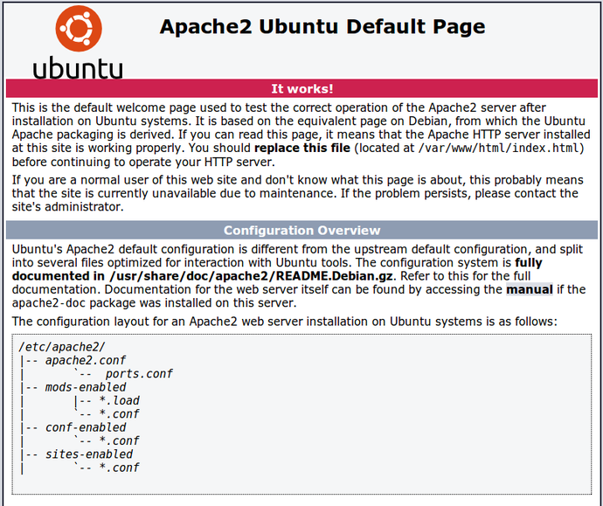
Apache
Apache manages user connections to a web server.
Represented by the apache2 package
Used in conjunction with the other parts of the LAMP stack to make a fully functioning web application

Slide 5
/var/www/html
This folder contains all the files that will be displayed on the web server. It is commonly referred to as the Document Root for the web server (aka webroot).
Check this folder for any unnecessary files

Slide 6
/etc/apache2/apache2.conf
ServerSignature Off
Prevents users from seeing the server signature which may contain sensitive information
ServerTokens Prod
Prevents users from getting information from server response headers
TraceEnable Off
Disables apache trace requests

Slide 7
apache2 permissions
chown -R www-data:www-data [webroot]
check /etc/apache2/envvars
make sure that run_user and run_group are both www-data

Slide 8
/etc/apache2/apache2.conf
<Directory />
Options None
AllowOverride None
Require all denied
</Directory>
Disables directory listing, symlinks, and server-side includes, and CGI script execution

Slide 9
/etc/apache2/apache2.conf (in case you have wordpress)
<Directory /var/www/html>
Options FollowSymLinks Indexes
AllowOverride All
Require all granted
</Directory>

Slide 10
MySQL
Serves as the database for storing information on the web server. A SQL (Structured Query Language) does what the name says. It allows for users to make structured requests to the database.
e.g. a very simple request could be “SELECT student FROM class”
Represented by the mysql-server package, but alternatives include postgresql, mariadb, and mongodb
You will rarely encounter a case where you have to check the databases for sensitive information, but if you do, you should be able to search up how to use basic database checking commands in MySQL

Slide 11
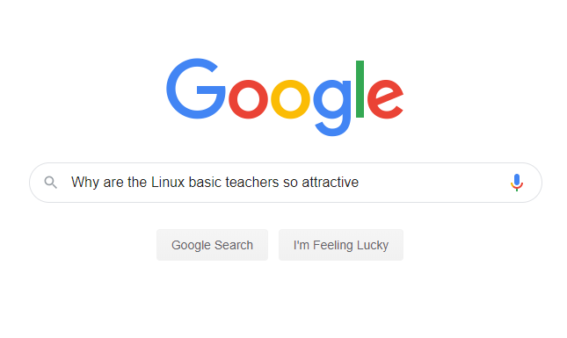
Unstructured Query
Notes:
You can just informally look up stuff
Doesnt have to be in any syntax, just ask away!

Slide 12
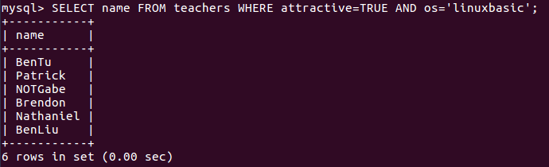
Structured Query
Notes:
a bit more complicated that unstructured
In a database you have to specify certain elements to pick from in
Thats why theres a bunch of keywords (in caps indicated on the image) to further specify

Slide 13
/etc/mysql/my.cnf
[mysqld]
bind-address=127.0.0.1
skip-show-database
DONT HAVE skip-grant-tables
user=mysql
port=3306
[mysql]
local-infile=0
bind-address restricts connections from remote hosts
skip-show-database prevents the listing of all databases unless one has proper permissions
local-infile prevents users from accessing the underlying filesystem

Slide 14
PHP
Scripting language used to run various tasks on a web server. Used mainly to create interactive/dynamic web pages.
Represented by the php7.0 package
Is notoriously hard and annoying to use

Slide 15
/etc/php/7.0/apache2/php.ini
expose_php = Off
Prevents server from returning headers
register_globals = Off
Prevents PHP from creating variables automatically from HTML form parameters/cookie data
file_uploads = Off
Prevents file uploads to server
disable_functions = exec,system,shell_exec,passthru,popen,curl_exec,curl_multi_exec,parse_ini_file, show_source,proc_open,pcntl_exec
Notes:
register_globals = Off has been removed as of php 5.4

Slide 16
Wordpress
Wordpress is a CMS (Content Management System) that allows users to create content without editing any HTML/CSS
This is just an extension of a LAMP stack as it has extra functionality via a web interface
Config file is at /var/www/html/wp-config.php
If you connect to “localhost” or “127.0.0.1” in your web browser, you should be able to access the Wordpress site if it is configured
Adding “/wp-admin” to the end allows you to access the admin panel to manage the website
check plugins, admins

